Slide 1
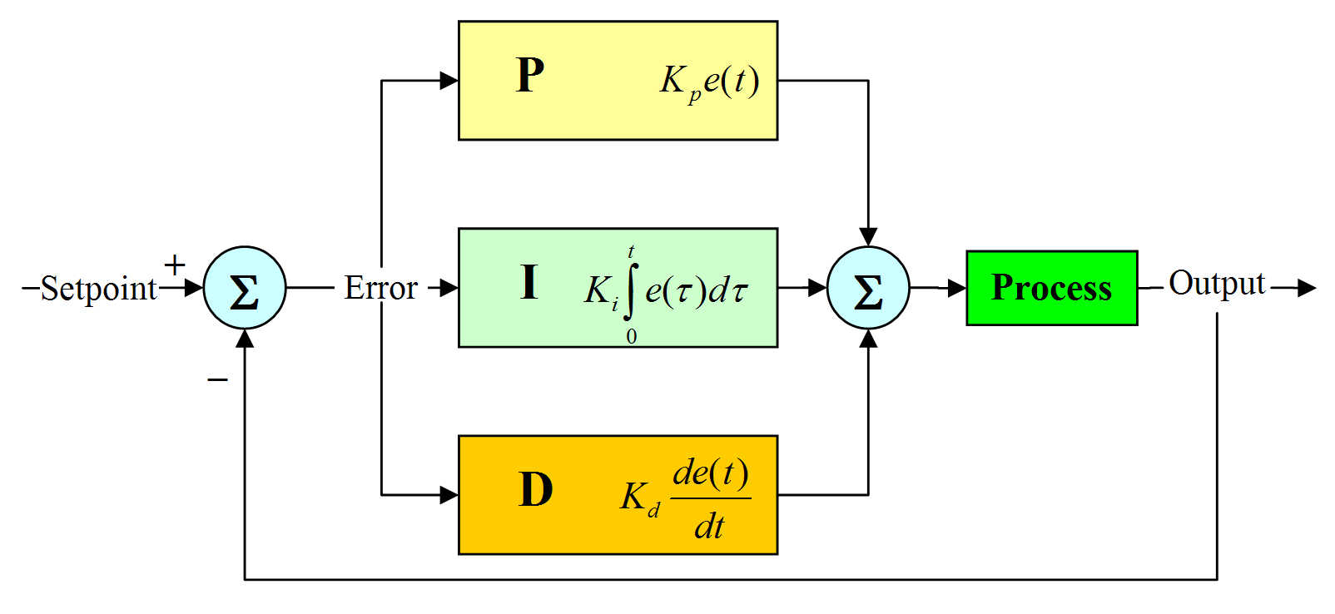
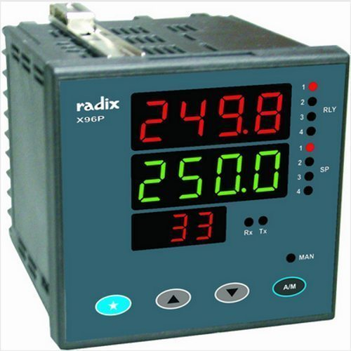
PID CONTROLLER
DIGITAL SIGNAL PROCESSING
CC01 – 1652252
VUONG LE HUY

Slide 2
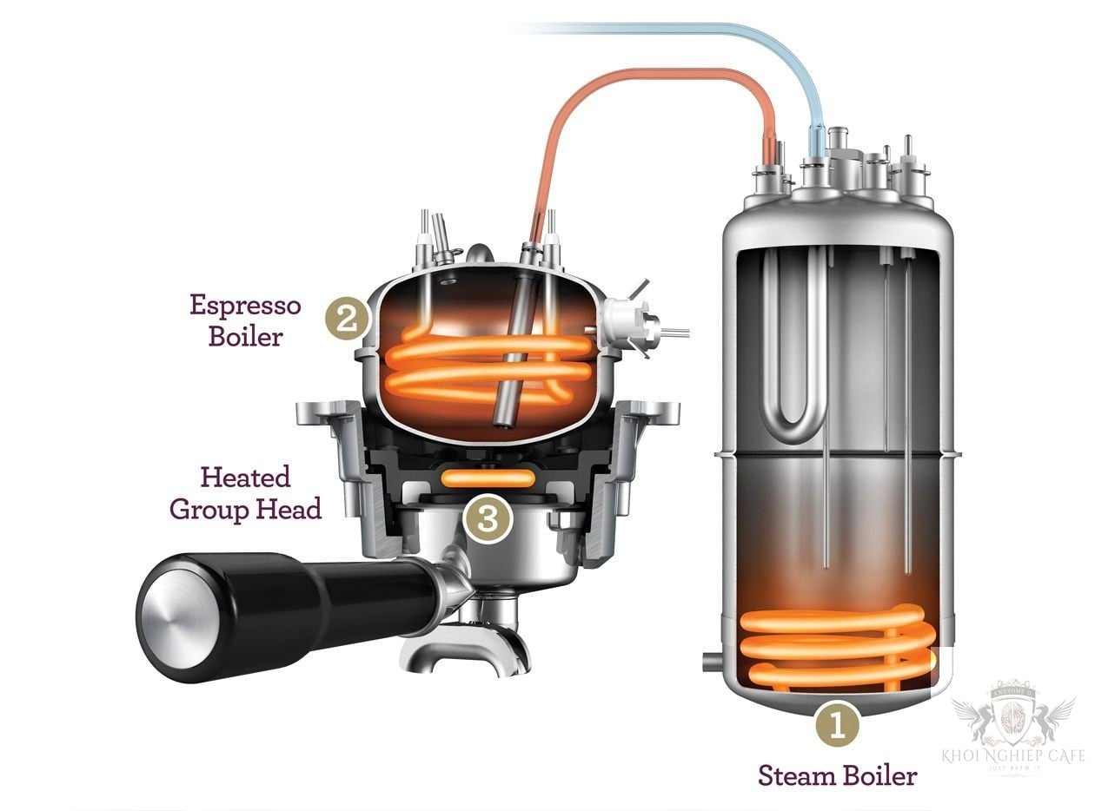
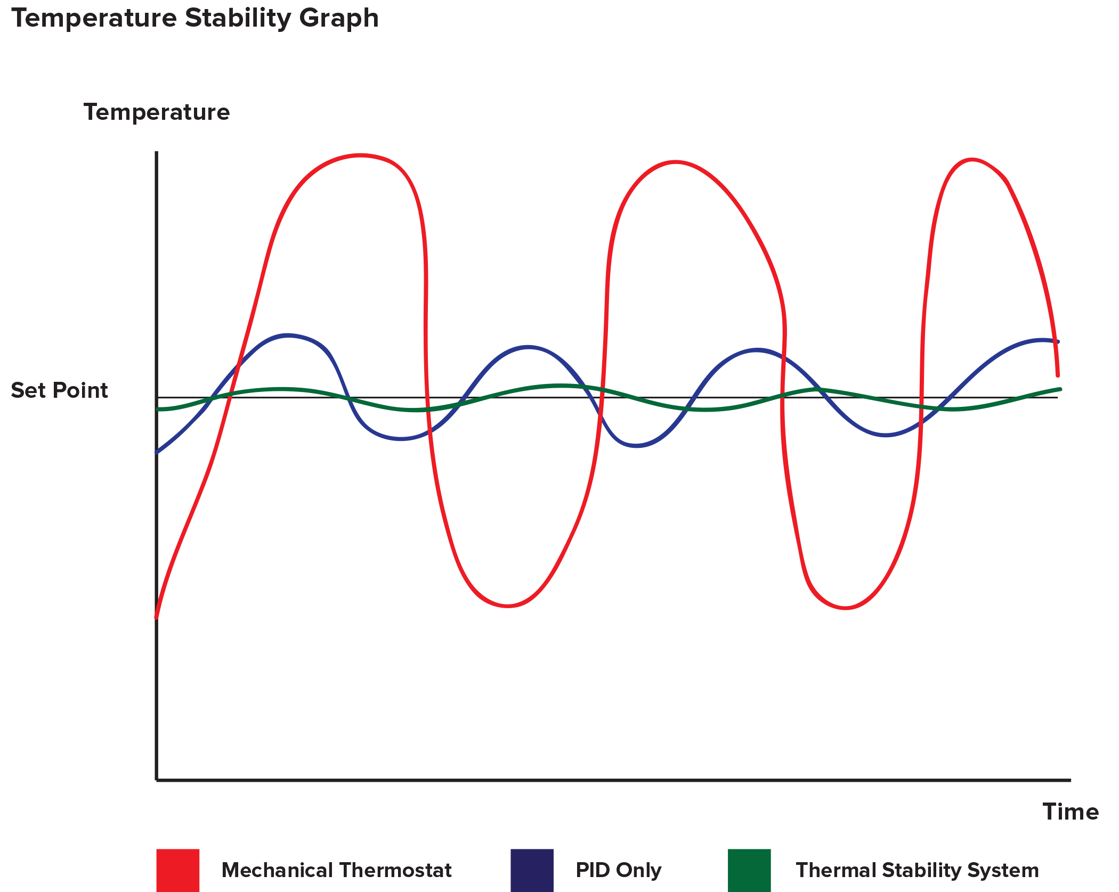
WHAT’S PID Controller FOR
VOLATILITY
LARGE VARIANCE

Slide 3
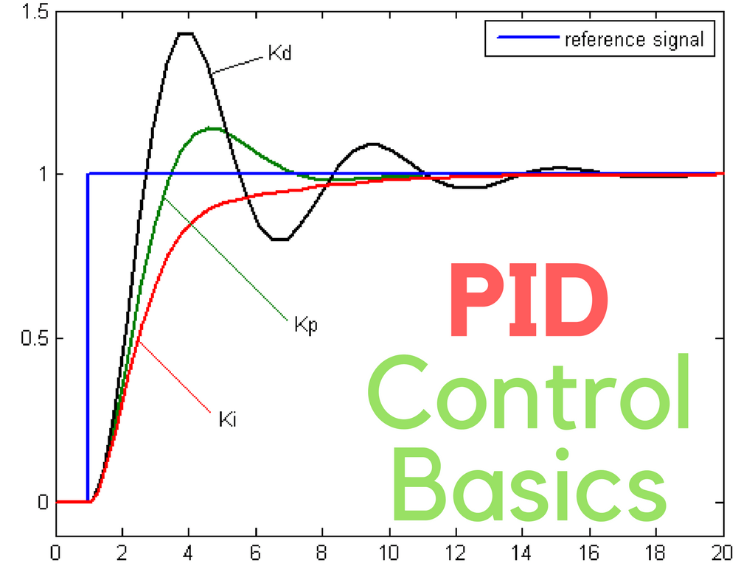
PID Proportional-Integral-Derivative
DEFINITION

Slide 4
LIST OF CONTENTS
WORKING PRINCIPLE
CALIBRATION PROCESS
P-CONTROLLER
I-CONTROLLER
D-CONTROLLER
Trial and Error Method
process reaction curve technique
Zeigler-Nichols method

Slide 5
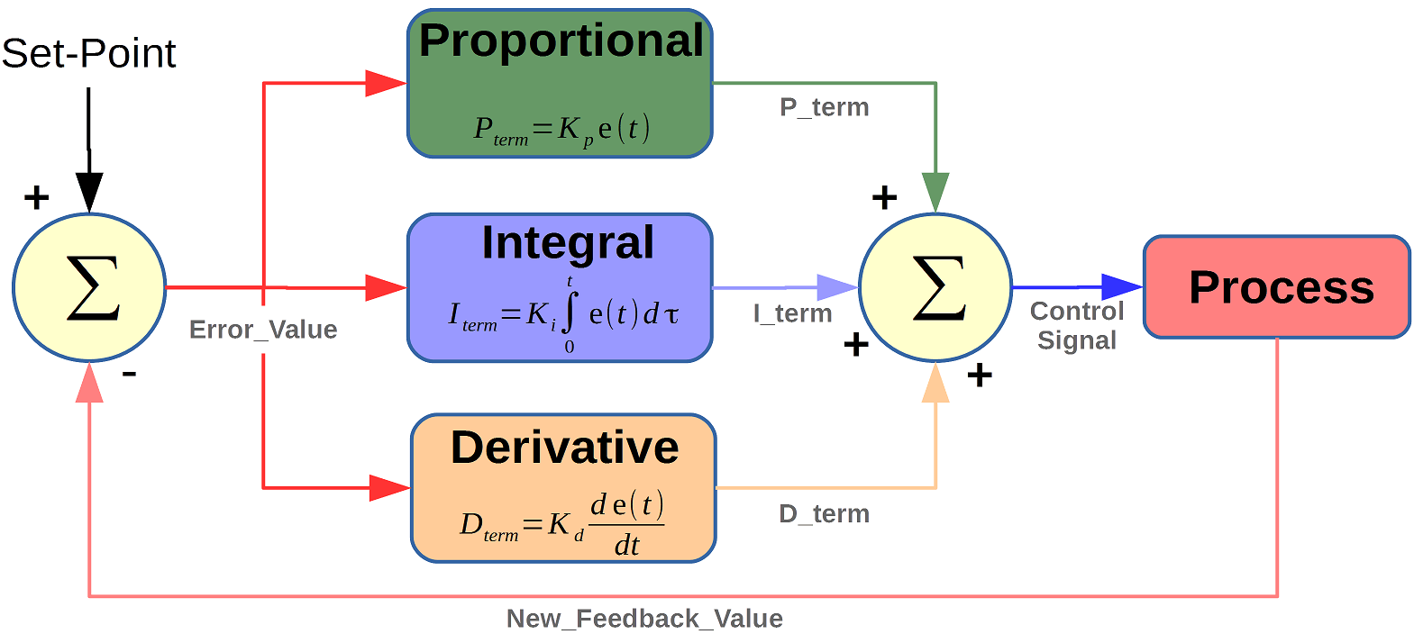
Working of PID Controller

Slide 6
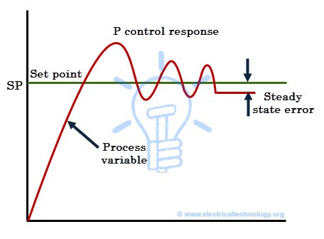
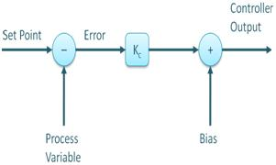
PROPORTIONAL Controller (P-CONTROLLER)

Slide 7
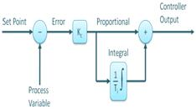
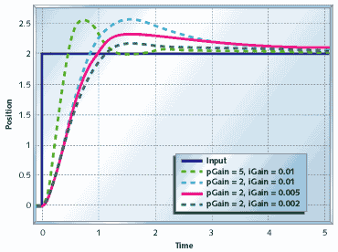
INTEGRAL Controller (I-Controller)
I-CONTROLLER limits the speed of response and affects stability of the system

Slide 8
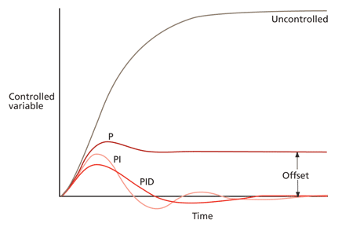
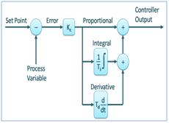
DERIVATIVE Controller (D-Controller)

Slide 9
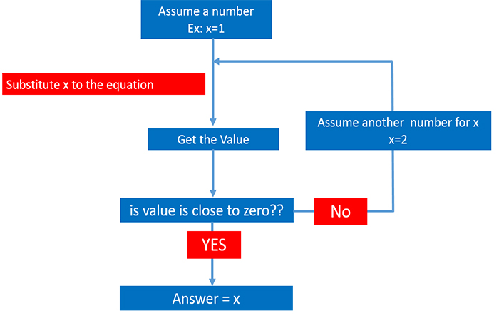
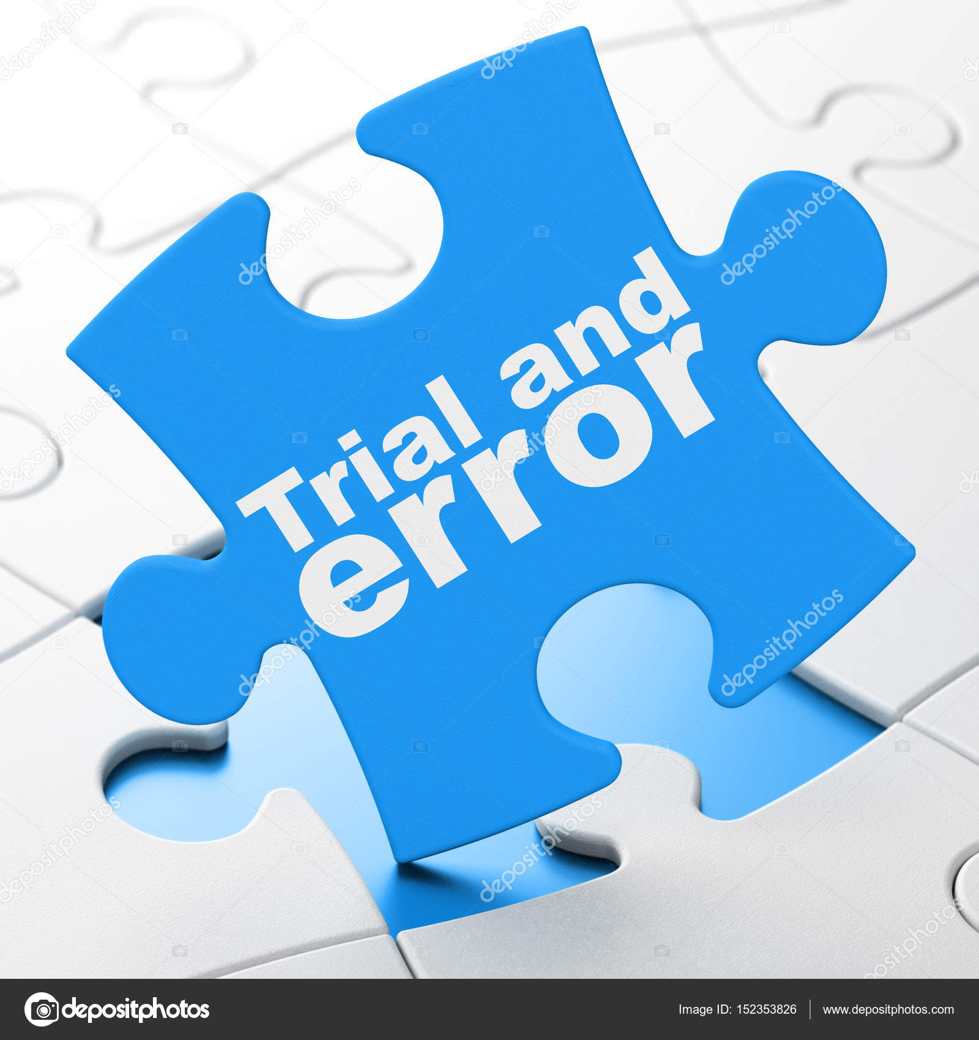
Trial and Error Method:
Tuning methods of PID Controller

Slide 10
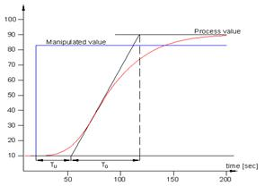
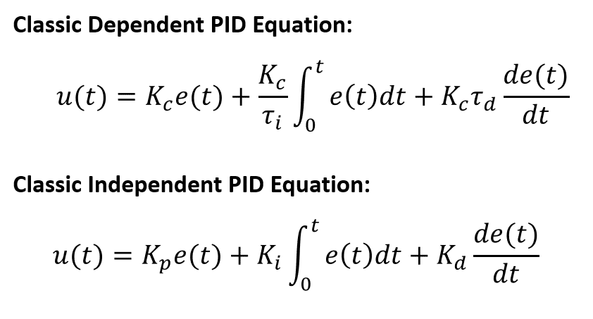
process reaction curve technique
Tuning methods of PID Controller

Slide 11
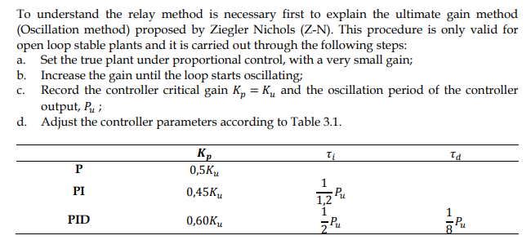
Zeigler-Nichols method:
Tuning methods of PID Controller

Slide 12
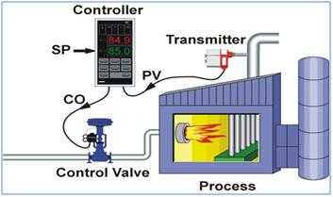
PID Controller Structure

